Slide 1
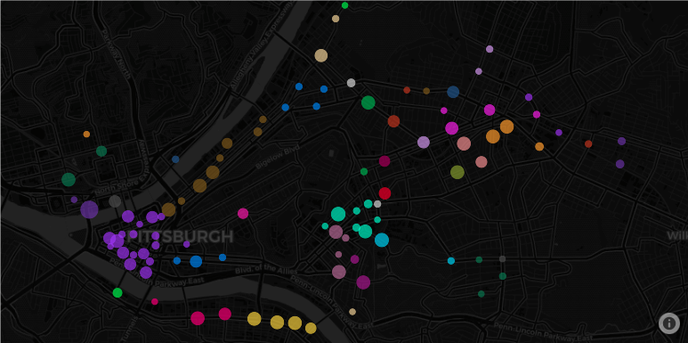

Reducing Discrimination in Learning Algorithms for Social Good in Sociotechnical Systems
Katelyn Morrison
Kmorrison@pitt.edu
Notes:
Hi everyone, my name is Katelyn Morrison and I am a final year undergrad at the University of Pittsburgh. My research currently focuses on analyzing and brainstorming methods to reduce discrimination in learning algorithms for social good in sociotechnical systems such as smart mobility systems.

Slide 2
Learning Algorithms for Smart Mobility Systems
The Motivation
Turn traditional transit into dynamic, affordable, and on-demand transit systems
Applications
Develop learning algorithms to provide insight and answer questions such as:
Ride sharing, electric bikes, electric scooters, etc.
Where to dispatch taxis & Ubers
Where to build bike stations
Where to redistribute bikes or electric scooters
Create reliable and sustainable transportation resources for all citizens
Predict behaviors and trends over space and time using models such as:
Improve access to education, jobs, and healthcare facilities
Random Forest [1]
Convolutional Neural Networks
[1] - Liu, Yijia, et al. “Scooter Equity and Demand Analysis.” UPenn MUSA, Master of Urban Spatial Analytics (MUSA) - University of Pennsylvania, 11 May 2020, pennmusa.github.io/MUSA_801.io/project_14/index.html#5_model_building.
Notes:
Several learning algorithms have been designed to augment traditional transportation systems into dynamic, affordable, and on-demand systems
such as ride sharing platforms, public bikes, and electric scooters. [ANIMATION 1]
These smart mobility systems create reliable and sustainable transportation resources which are vital to the stability and growth of a city. [ANIMATION 2]
Ultimately, these smart mobility systems equipped with data-driven learning algorithms will provide citizens with access to education, jobs, and health care facilities. [ANIMATION 3]
To ensure these resources are provided and used efficiently and effectively, researchers have employed learning algorithms that provide insight to help planners and policymakers decide [ANIMATION 4]
where to dispatch taxis or Ubers [ANIMATION 5]
Where to build bike stations [ANIMATION 6]
And where to redistribute bikes or electric scooters [ANIMATION 7]
These questions have been tackled primarily by predicting behaviors and trends over space and time using models such as [ANIMATION 8]
Convolutional neural networks and another model [ANIMATION 9]

Slide 3
Discrimination in Smart Mobility Systems
Pittsburgh’s Healthy Ride Bike Share
New Station Locations
Presented as an exploration vs exploration problem
100 bike stations – 550 bikes
5% of the stations in neighborhoods with poor housing*
Model-based reinforcement learning paired with Bayesian Optimization
Satisfy statical parity by mapping features to new distribution [Zemel et. al 2013]
Future Work
Develop, train, and test the model
Identify new datasets to include
Identify other potential models to use
Notes:
Some of my preliminary analyses on Pittsburgh’s Healthy Ride Bike Sharing Program reveal that 5% of the bike stations are in neighbors with poor housing conditions.
Here you can see the stations colored by census tract and identifies the station’s capacity as well as that census tract’s median household income in 2015. [ANIMATION 1]
The visualization shows that more bike stations have been placed in neighborhoods with a higher median household income.
As any city starts or wants to expand their bike sharing program, they face an exploration vs exploitation problem. [ANIMATION 2]
I have been investigating how to potentially leverage model-based reinforcement learning paired with Bayesian Optimization to tackle this agenda. [ANIMATION 3]
To avoid biases or discrimination, I am also investigating how the model I create can satisfy statistical parity. [ANIMATION 4]
Moving forward I will be developing, training, and testing a model for this work.
I have also identified several datasets including the Median Household Income and Community Need Index to evaluate and potentially include. [ANIMATION 5]
Finally, I would like to identify other potential models that could be used [ANIMATION 6]

Slide 4
Reducing Discrimination in Learning Algorithms for Social Good in Sociotechnical Systems
Thanks to the workshop organizers, reviewers and mentors!
Katelyn Morrison
Kmorrison@pitt.edu
Notes:
Thank you to the workshop organizers, the reviewers, and my mentors. Be sure to check out my related works section where I identify the few other academic contributions related to this paper.

